Slide 1


Team 30: ECEN 215 Lab Kit
Bi-Weekly Update 4 Members: Luis Diaz-Santini, Yusuf Hossain,
Ryan Freed, and Peter Zhang Sponsor: Dr. Lusher
TA: Garret Brown
Notes:
Intro should take 30 seconds

Slide 2
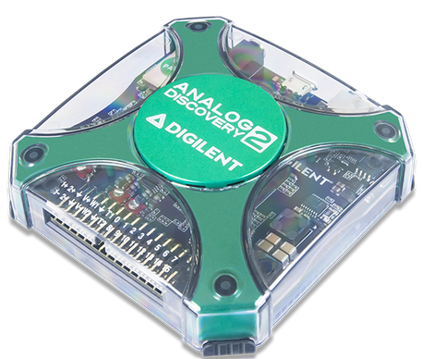
Project Summary
Problem Statement:
Principles of Electrical Engineering (ECEN 215) teaches the basics of electric circuit analysis and electronics to non-ECEN majors.
The transition of ECEN 215 to an online format poses a challenge due to its lab component relying on the Analog Discovery 2 (AD2), which is expensive.
Solution Proposal:
The ECEN 215 Lab Kit offers a solution to the cost, convenience, and over complication issues that are abundant with the AD2. Aiming for a $50 price point, the lab kit offers a more catered simpler approach to each lab while also making it possible to complete at home.
Will operate as the power supply, signal generator, multimeter, and Oscilloscope.

Slide 3
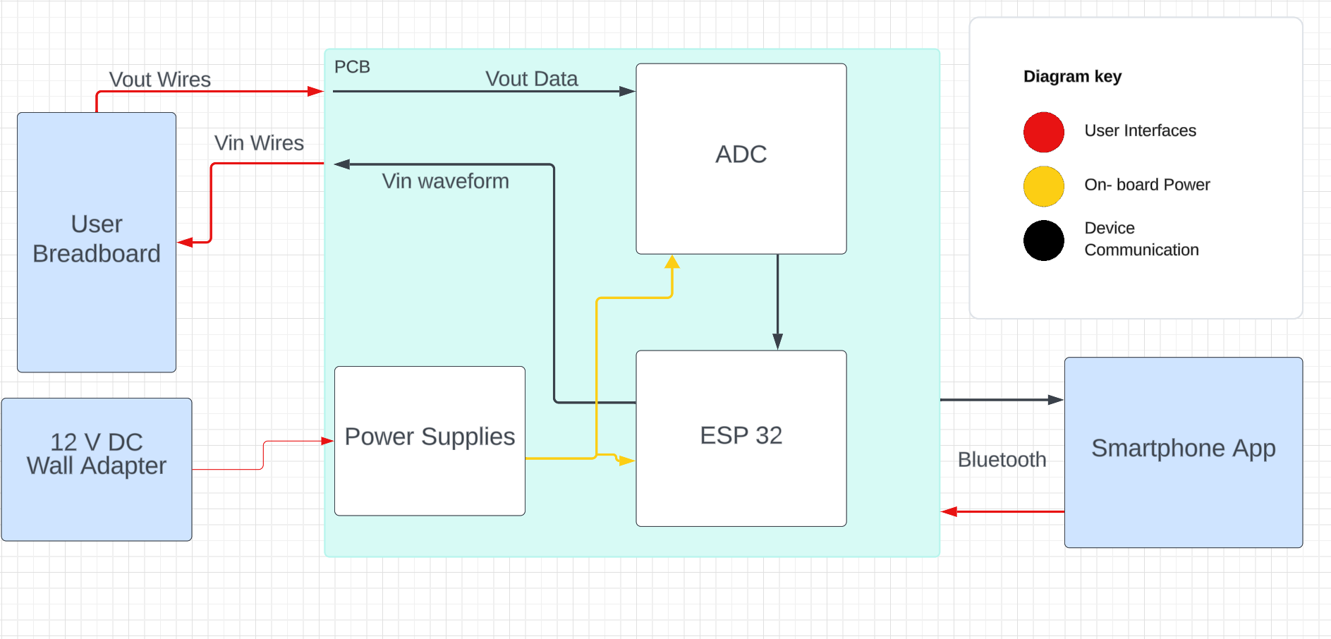
Subsystems Overview
Peter: Multimeter and Oscilloscope
Yusuf: Waveforms and communicating to the microcontroller.
Luis: Mobile application to interface with device
Ryan: PCB design and power.

Slide 4
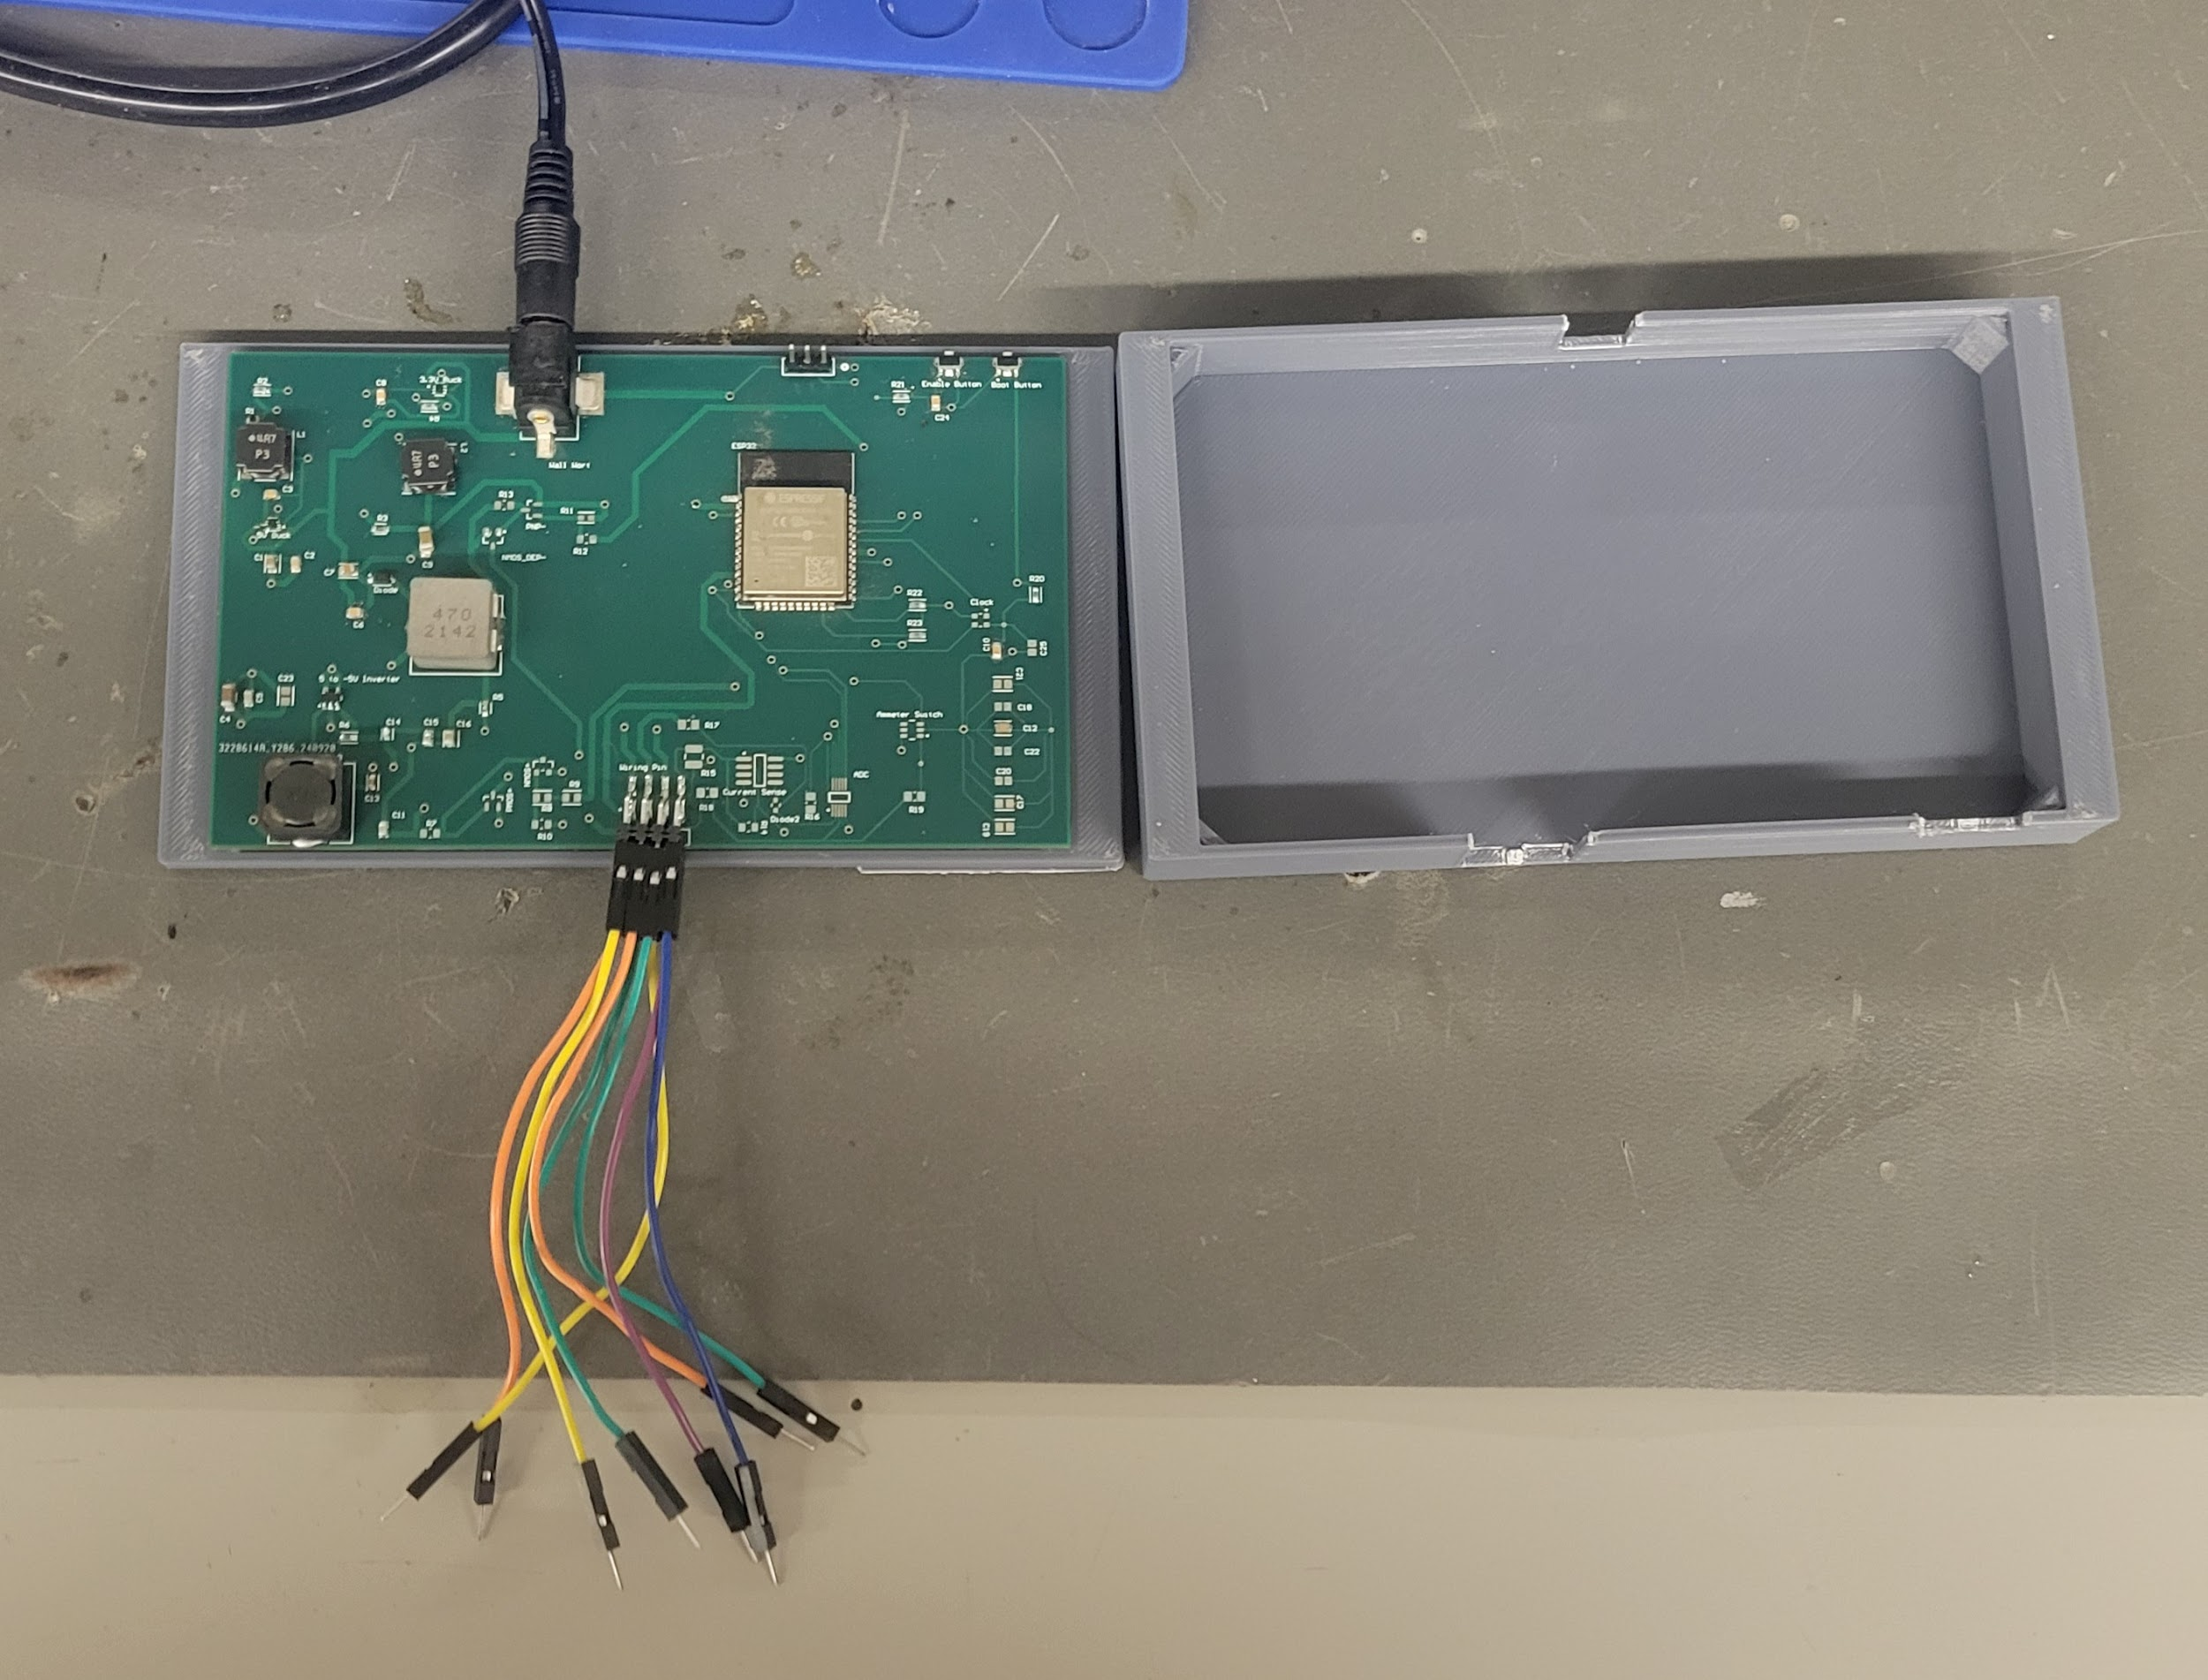
Integrated System Diagram
Pins:
+5 V supply, -5 V supply, GND, Waveform,
Amm+, Amm-, Voltmeter+, Voltmeter-,
(Ohmmeter+,
Ohmmeter-)

Slide 5
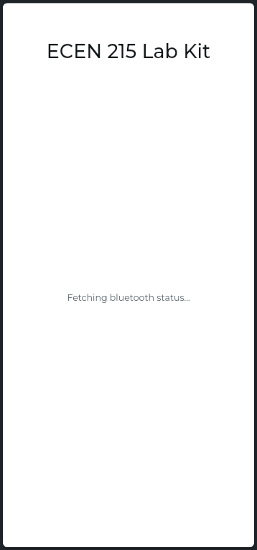
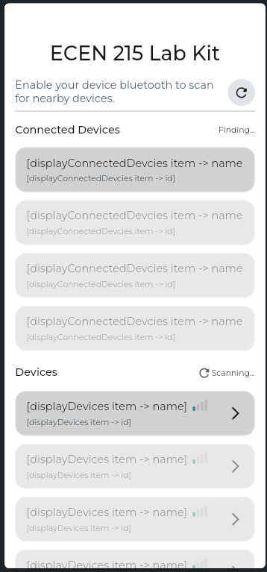
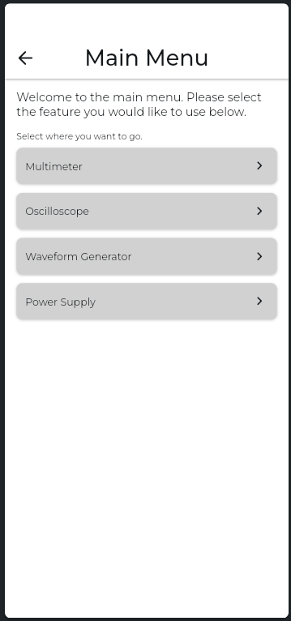
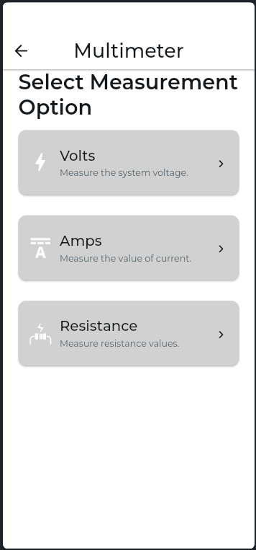
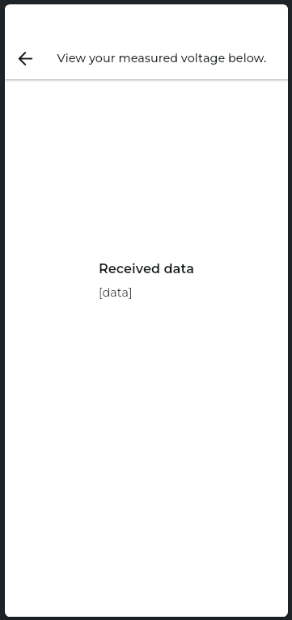
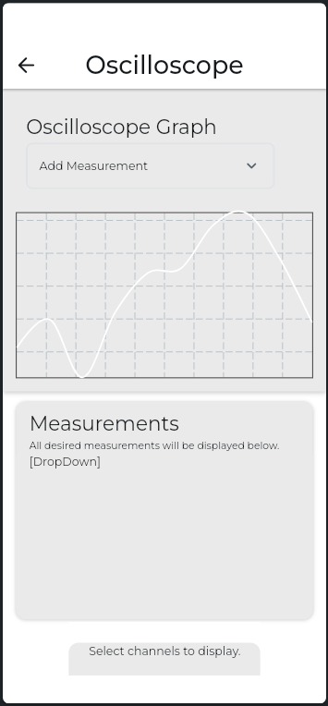
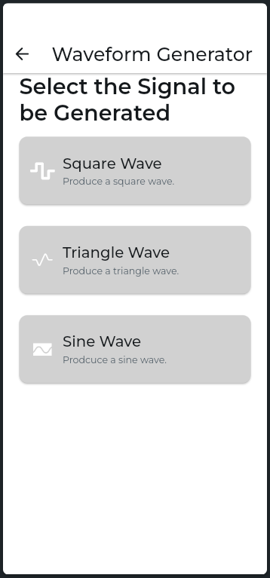
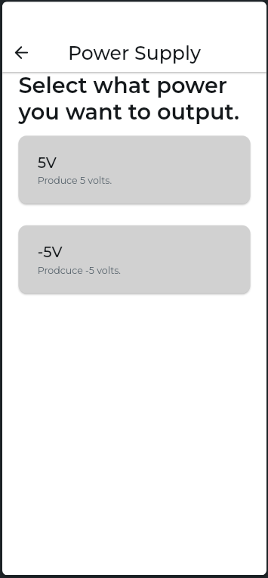
Integrated System Diagram

Slide 6
Project Timeline
Ensure Working Subsystem (completed 8/22) | Research Integrating / Ensure Working Subsystems (completed 8/29) | Integrate App with Wave Gen and Multimeter (to complete by 9/24) | Integrate App with Oscilloscope / Integrated Testing (to complete by 10/16) | Complete Testing of Integrated Subsystems (to complete by 10/30) | Complete Validation of Integrated Subsystem (to complete by 11/7 | Documentation and Buffer Time (to complete by 11/10)

Slide 7
Waveform Generator
Yusuf Hossain
Accomplishments since last update 14 hrs of effort | Ongoing progress/problems and plans until the next presentation
Able to boot wavegen code onto ESP32 attached to the PCB using TTL Wavegen is able to activate via BLE connection through the app | Form continuous waveform on mobile app for all waveform shapes Smooth out graphs on PCB ESP32 Display waveforms and characteristics of the graphs on the mobile app

Slide 8
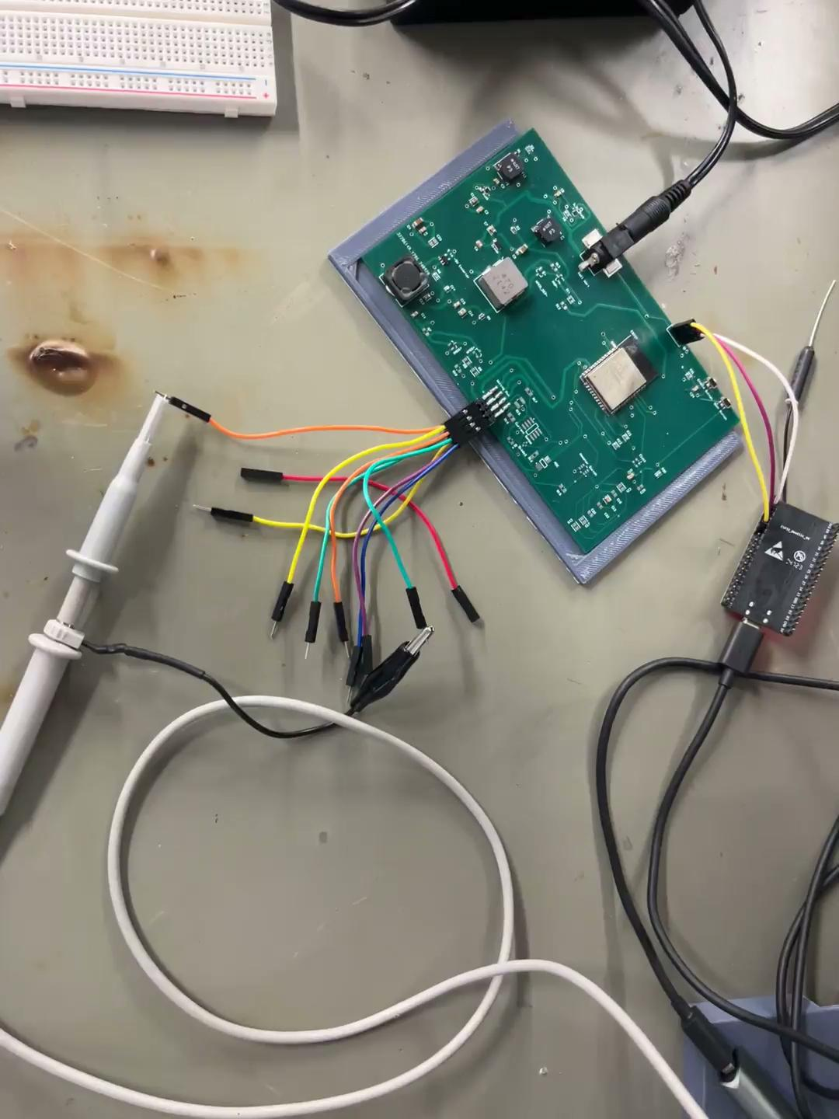

Slide 9
Mobile App
Luis Diaz-Santini
Accomplishments since last update 20 hrs of effort | Ongoing progress/problems and plans until the next presentation
Waveforms activate after user input through app App input activates 5 volt and -5 volt supplies | Solve (potential) memory issue with ESP32 Clean up noise on waveform and finalize square/triangle waves Test power supply GPIO activation with PCB

Slide 10
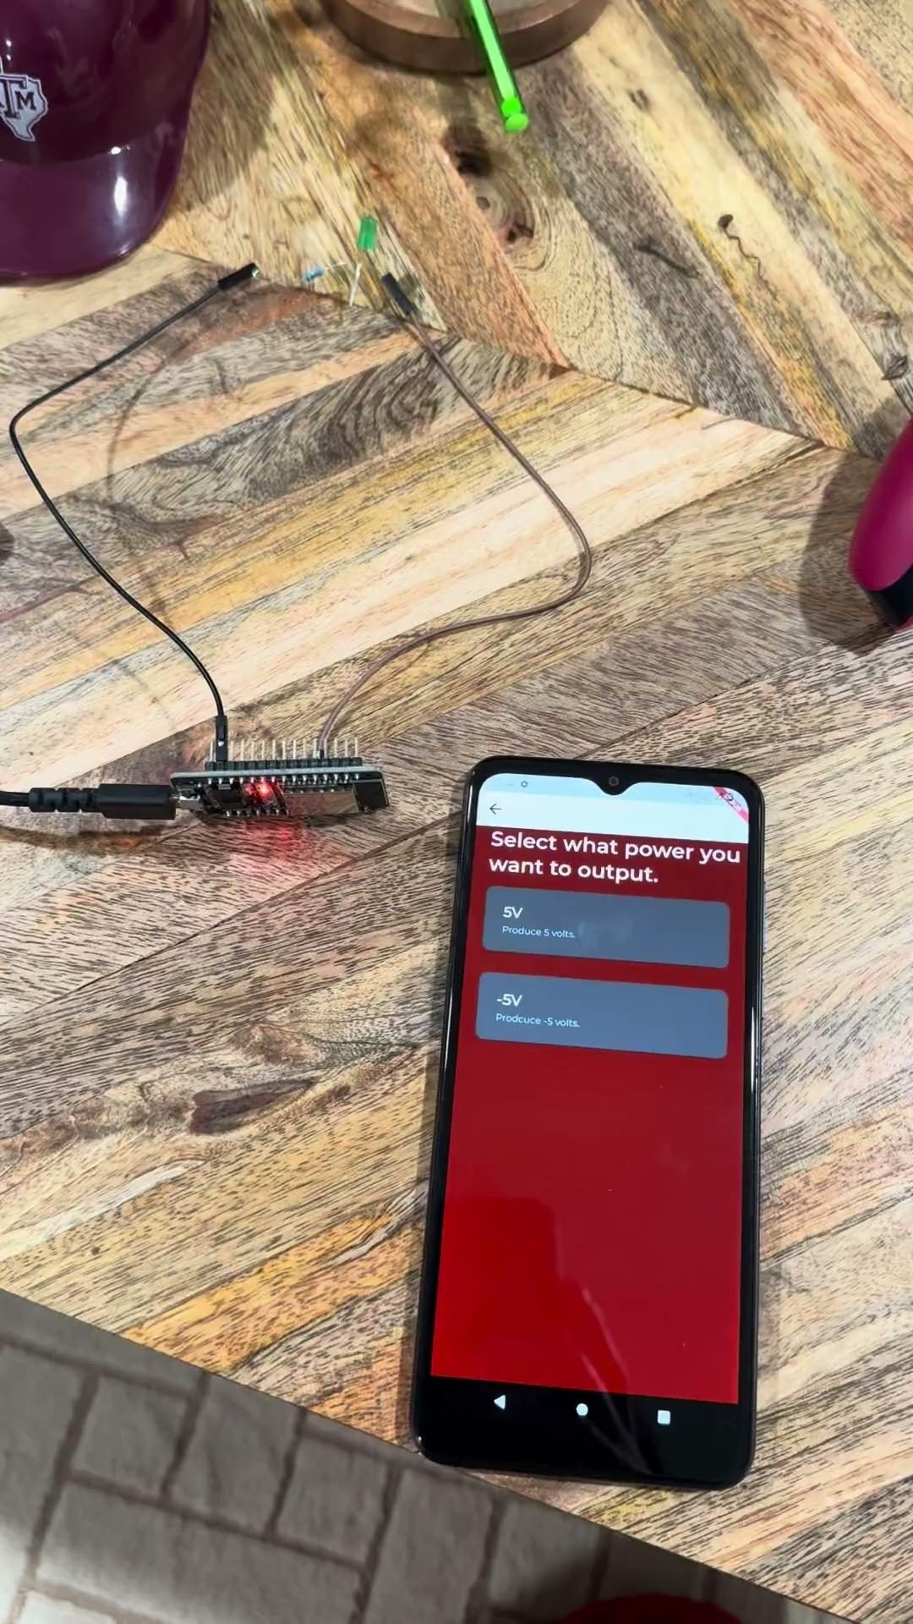
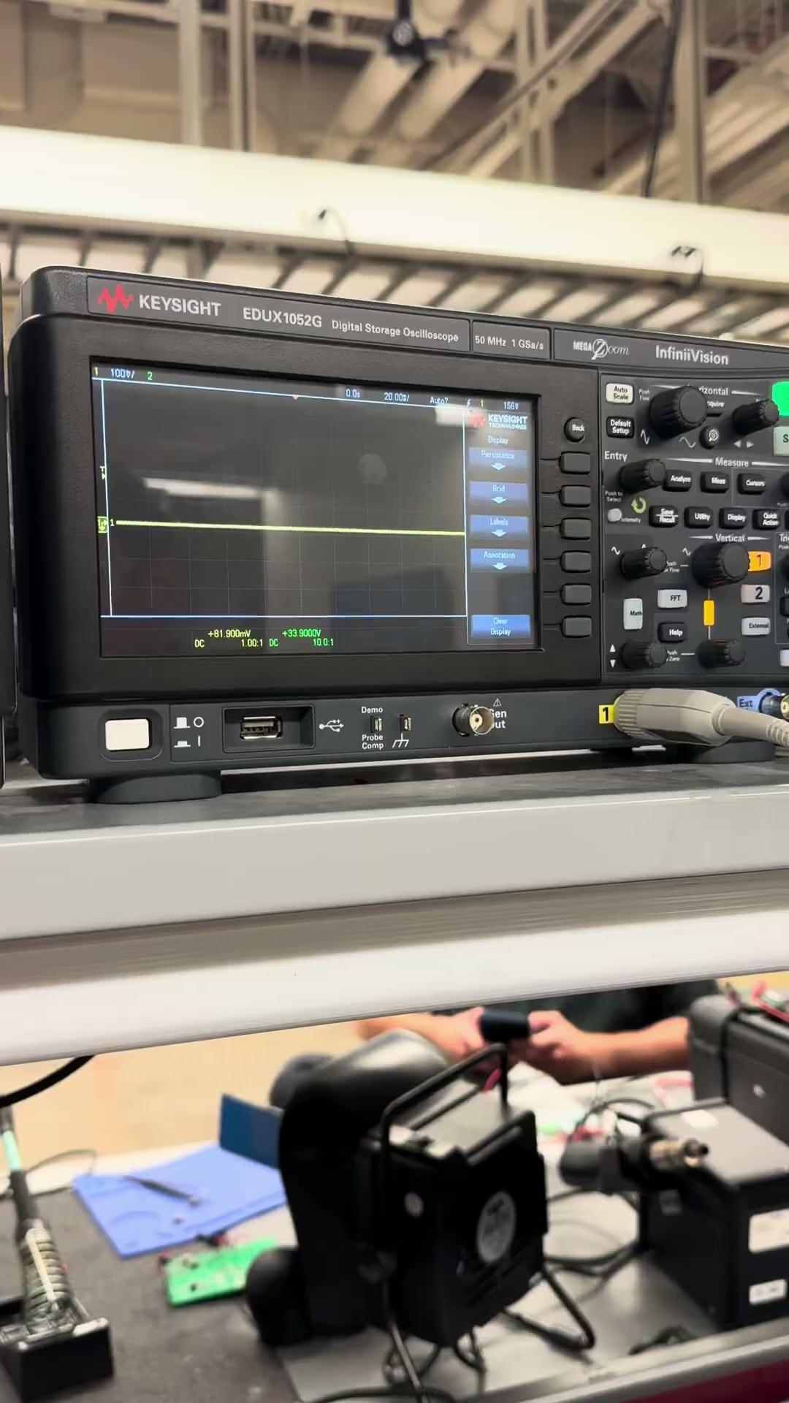

Slide 11
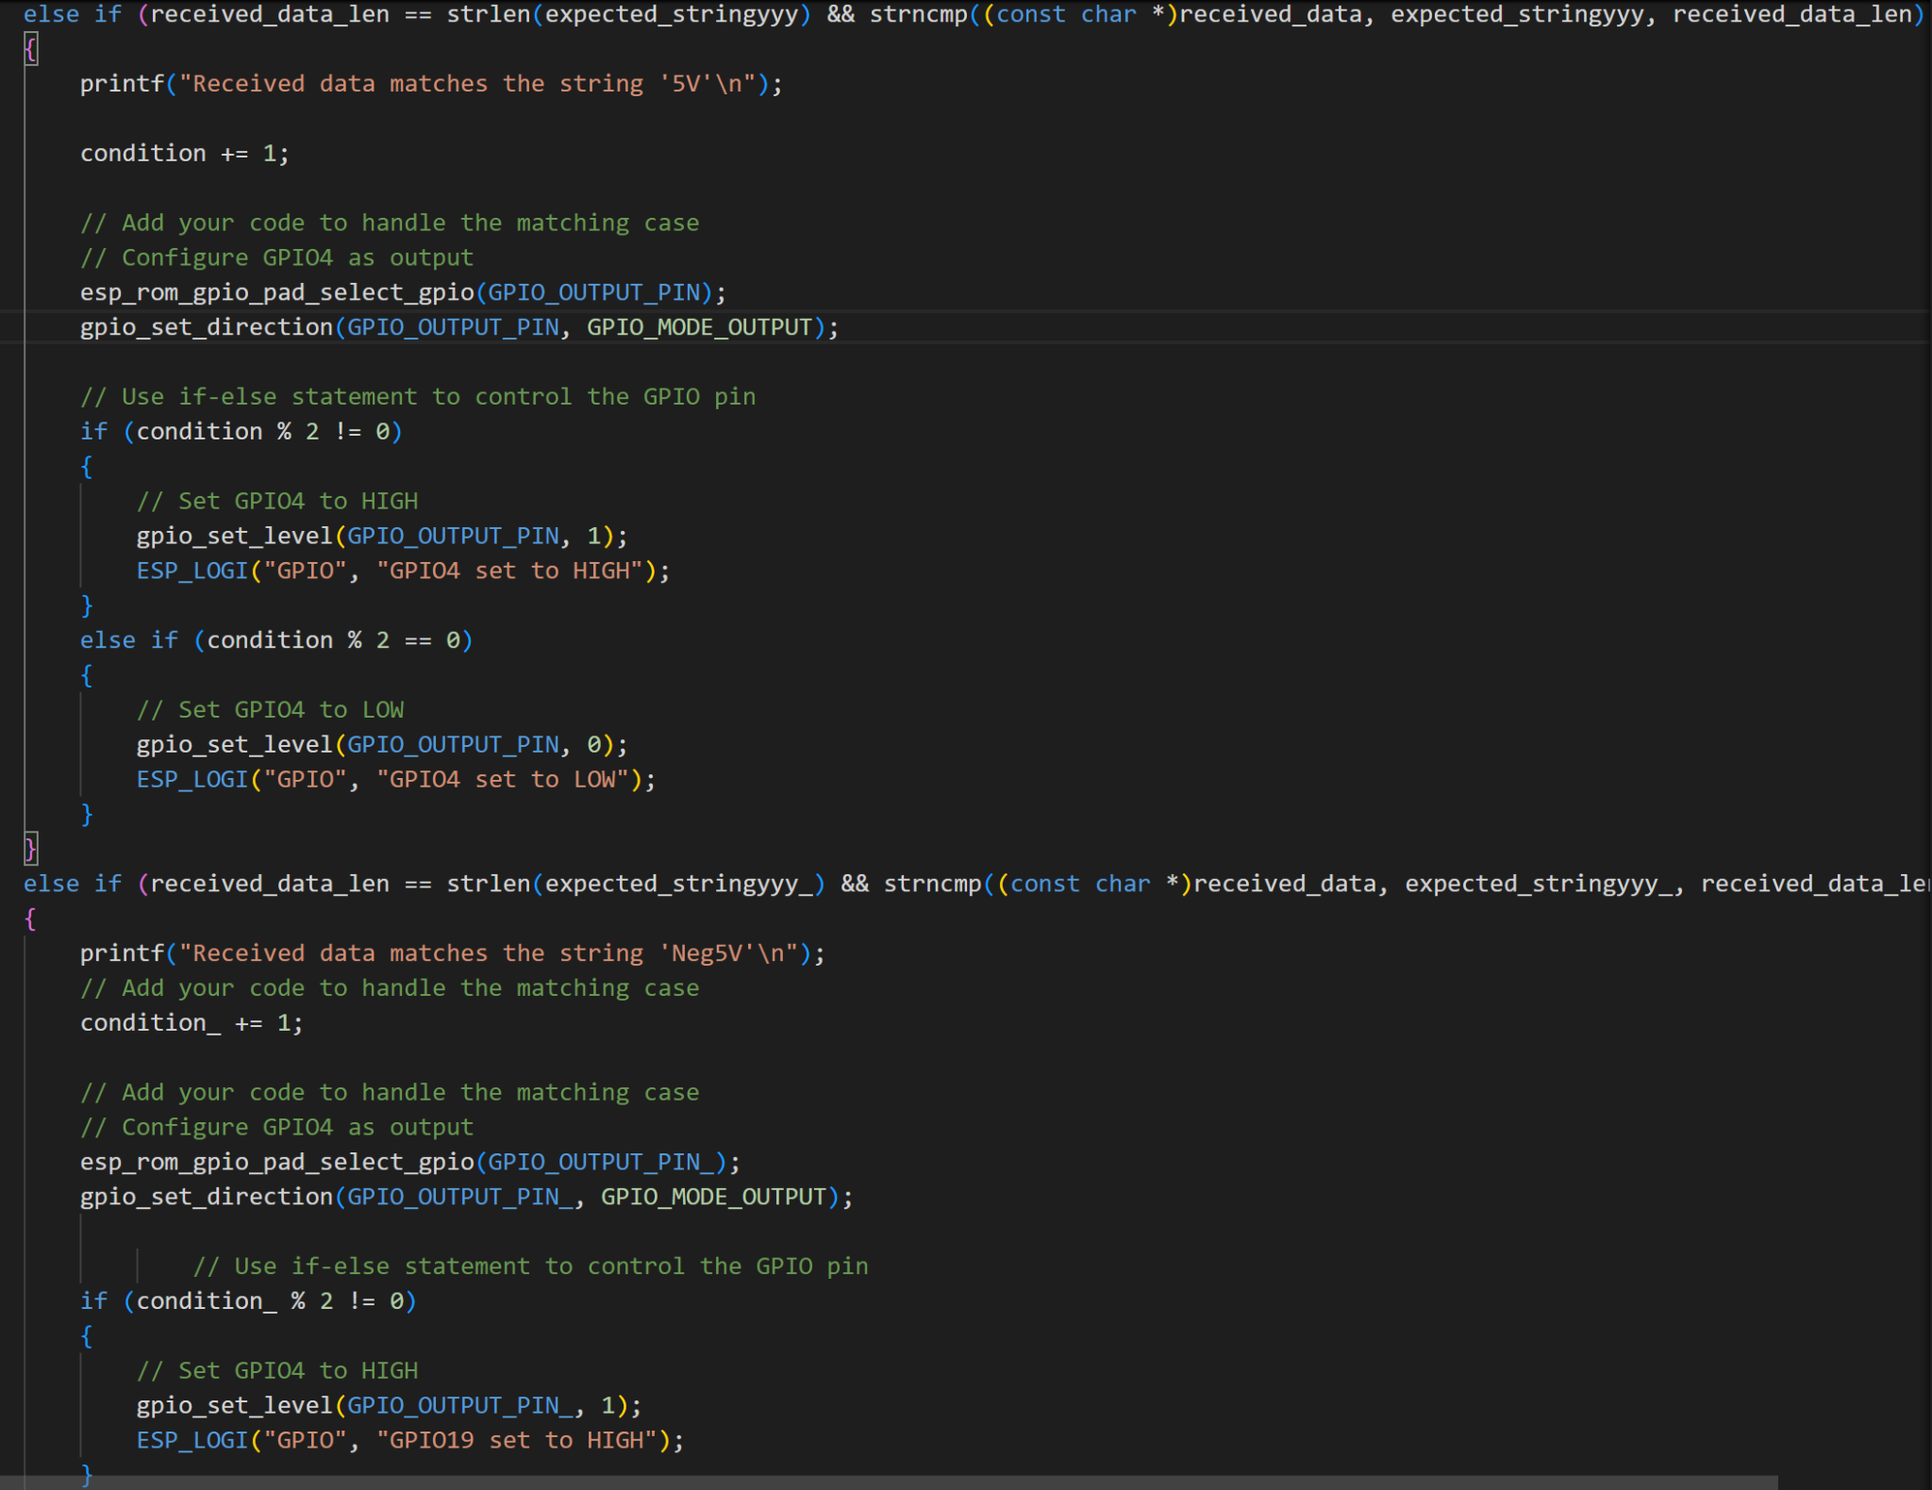

Slide 12
Oscilloscope and Multimeter
Peter Zhang
Accomplishments since last update 19 hrs of effort | Ongoing progress/problems and plans until the next presentation
Ammeter, ohmmeter, and voltmeter sends data to app App displays values from multimeter | Implementation of real time plotting oscilloscope on application Limited size of BLE attribute buffer, so only able to send one pair of voltage and time Testing precision of multimeter measurements Memory issues

Slide 13
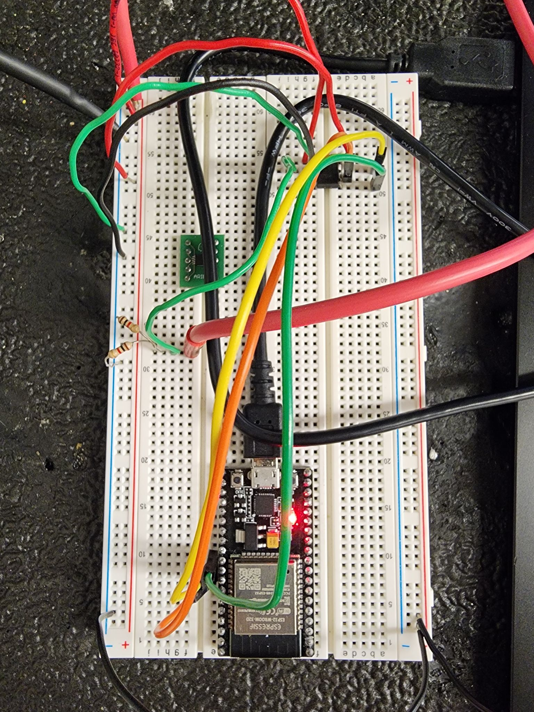
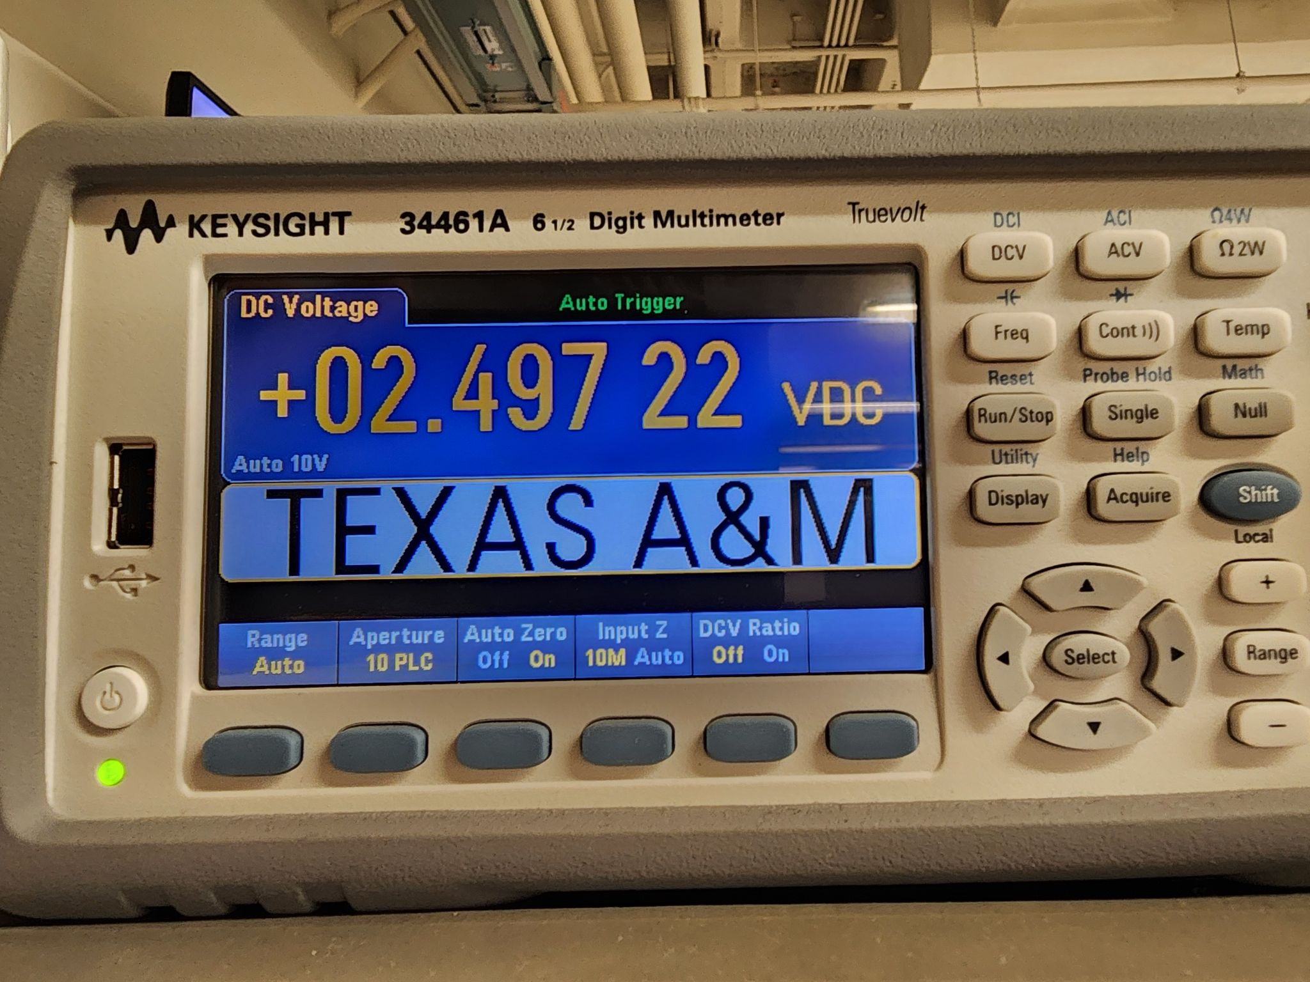
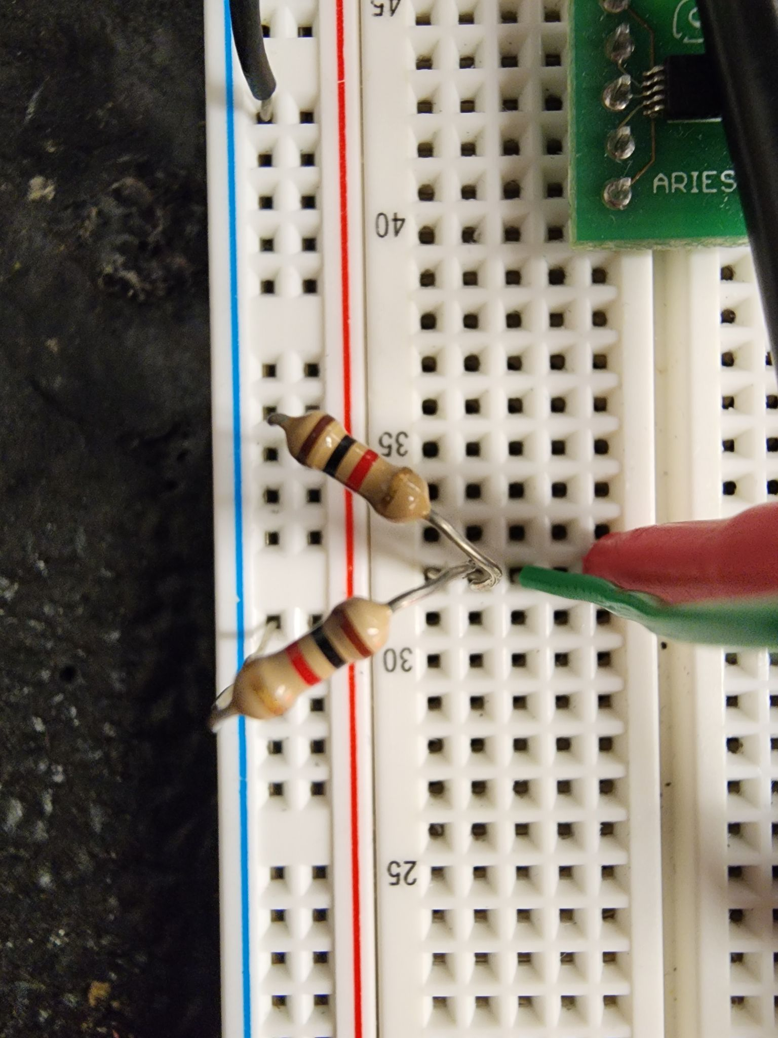

Slide 14
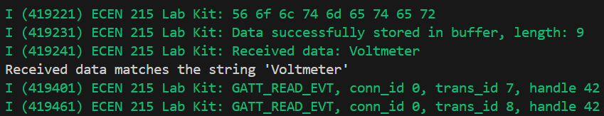
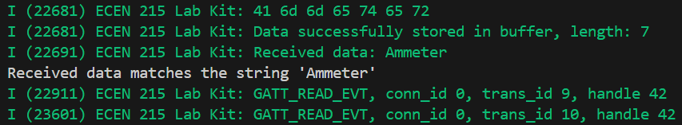
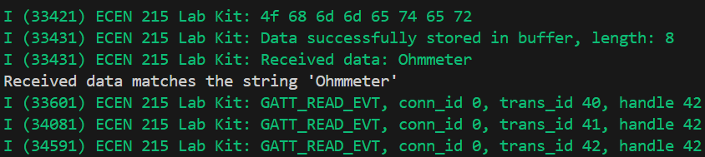
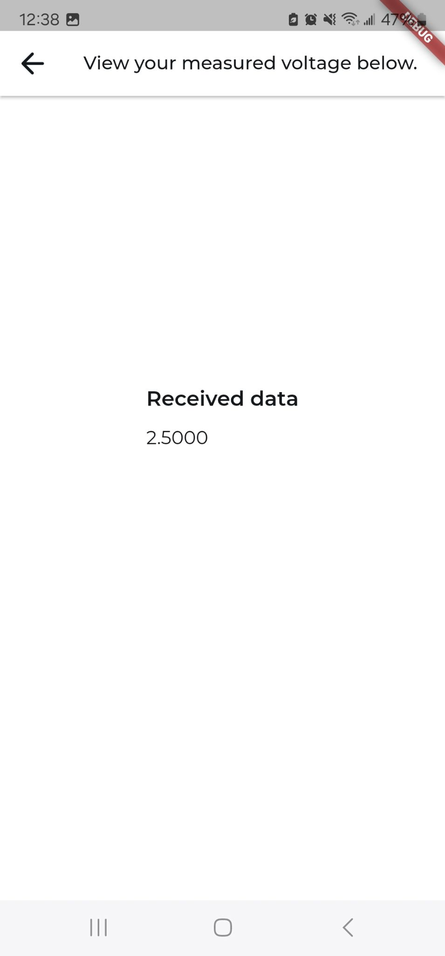
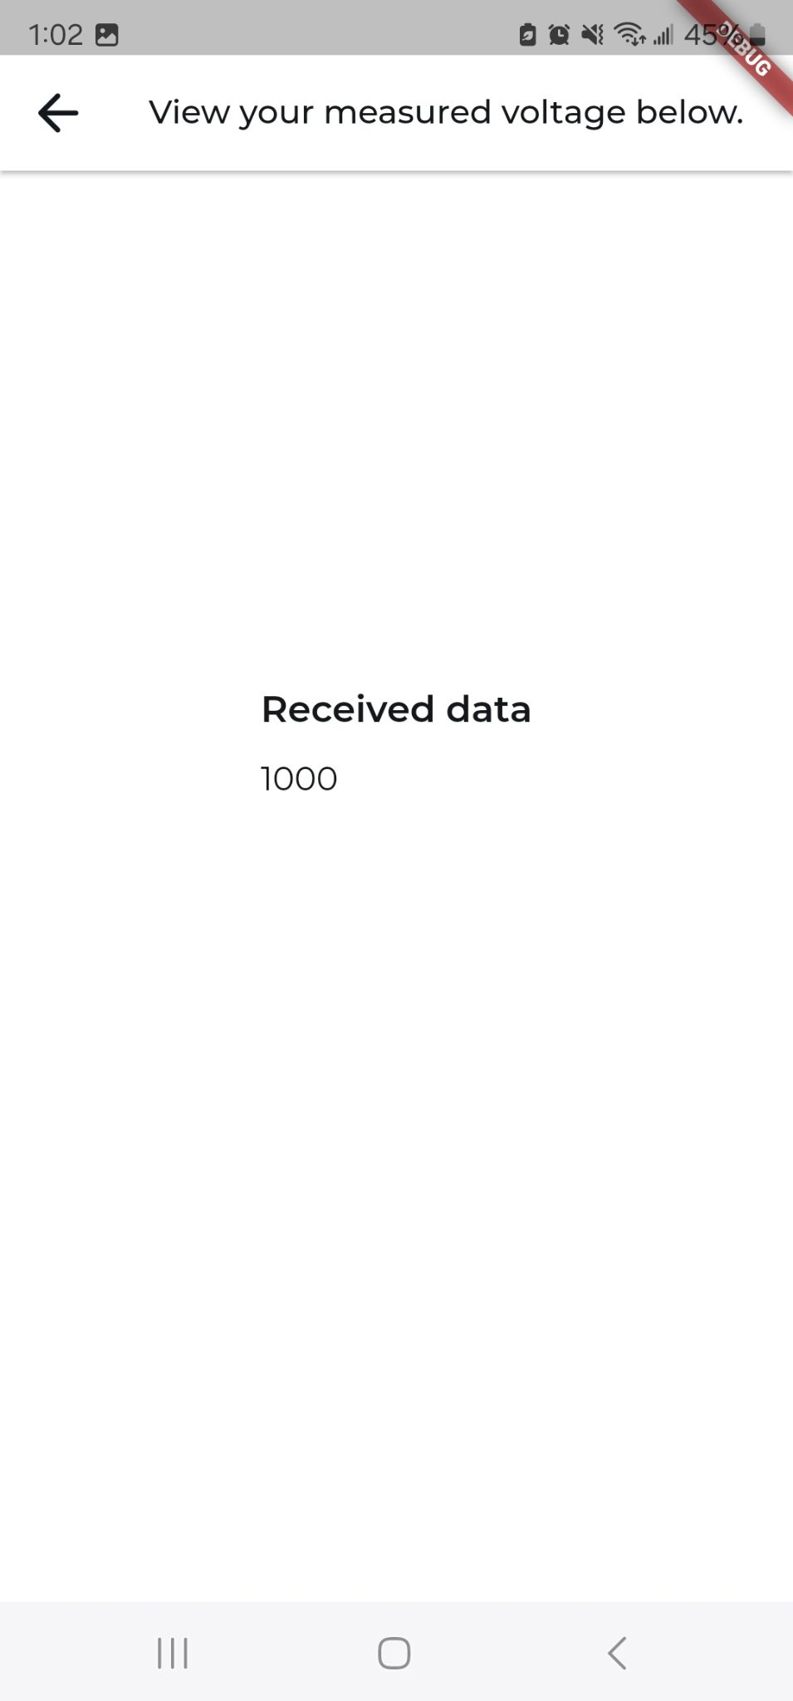
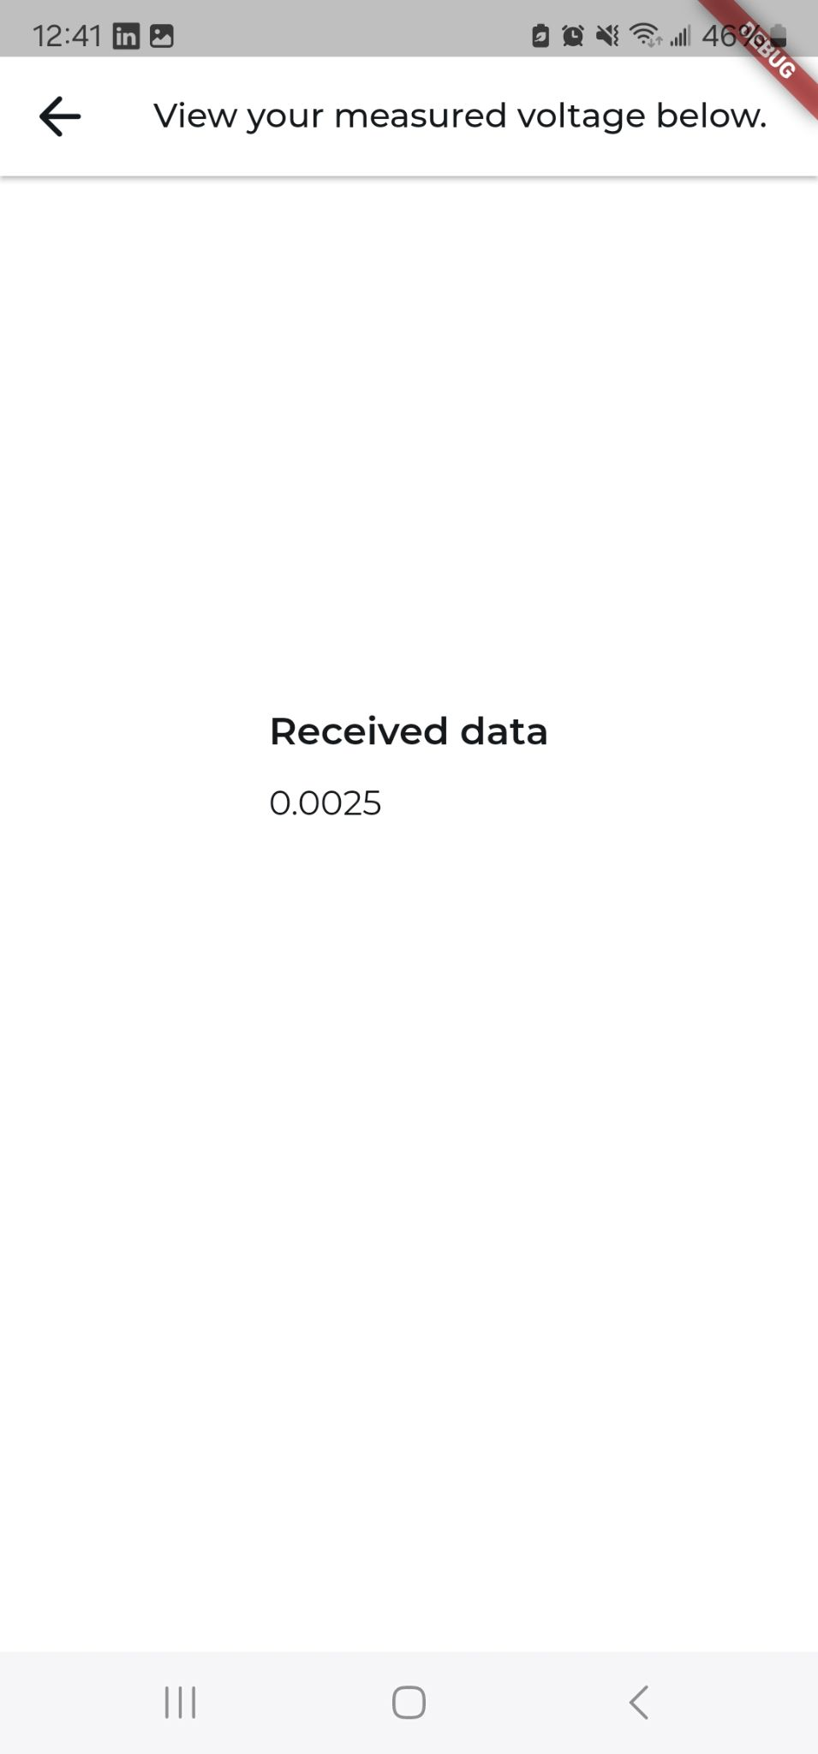

Slide 15
PCB and Power
Ryan Freed
Accomplishments since last update 54 hrs of effort | Ongoing progress/problems and plans until the next presentation
Assembled and tested 3.3 V, 5 V, and -5 V converters Tested 5 V supply switching system, began integration of -5 V supply switch Began loading code from Devkit to ESP | -5 V supply switch does not turning off as expected ESP is receiving code but not still is not generating waveforms as expected Integrate and test voltmeter prototype

Slide 17
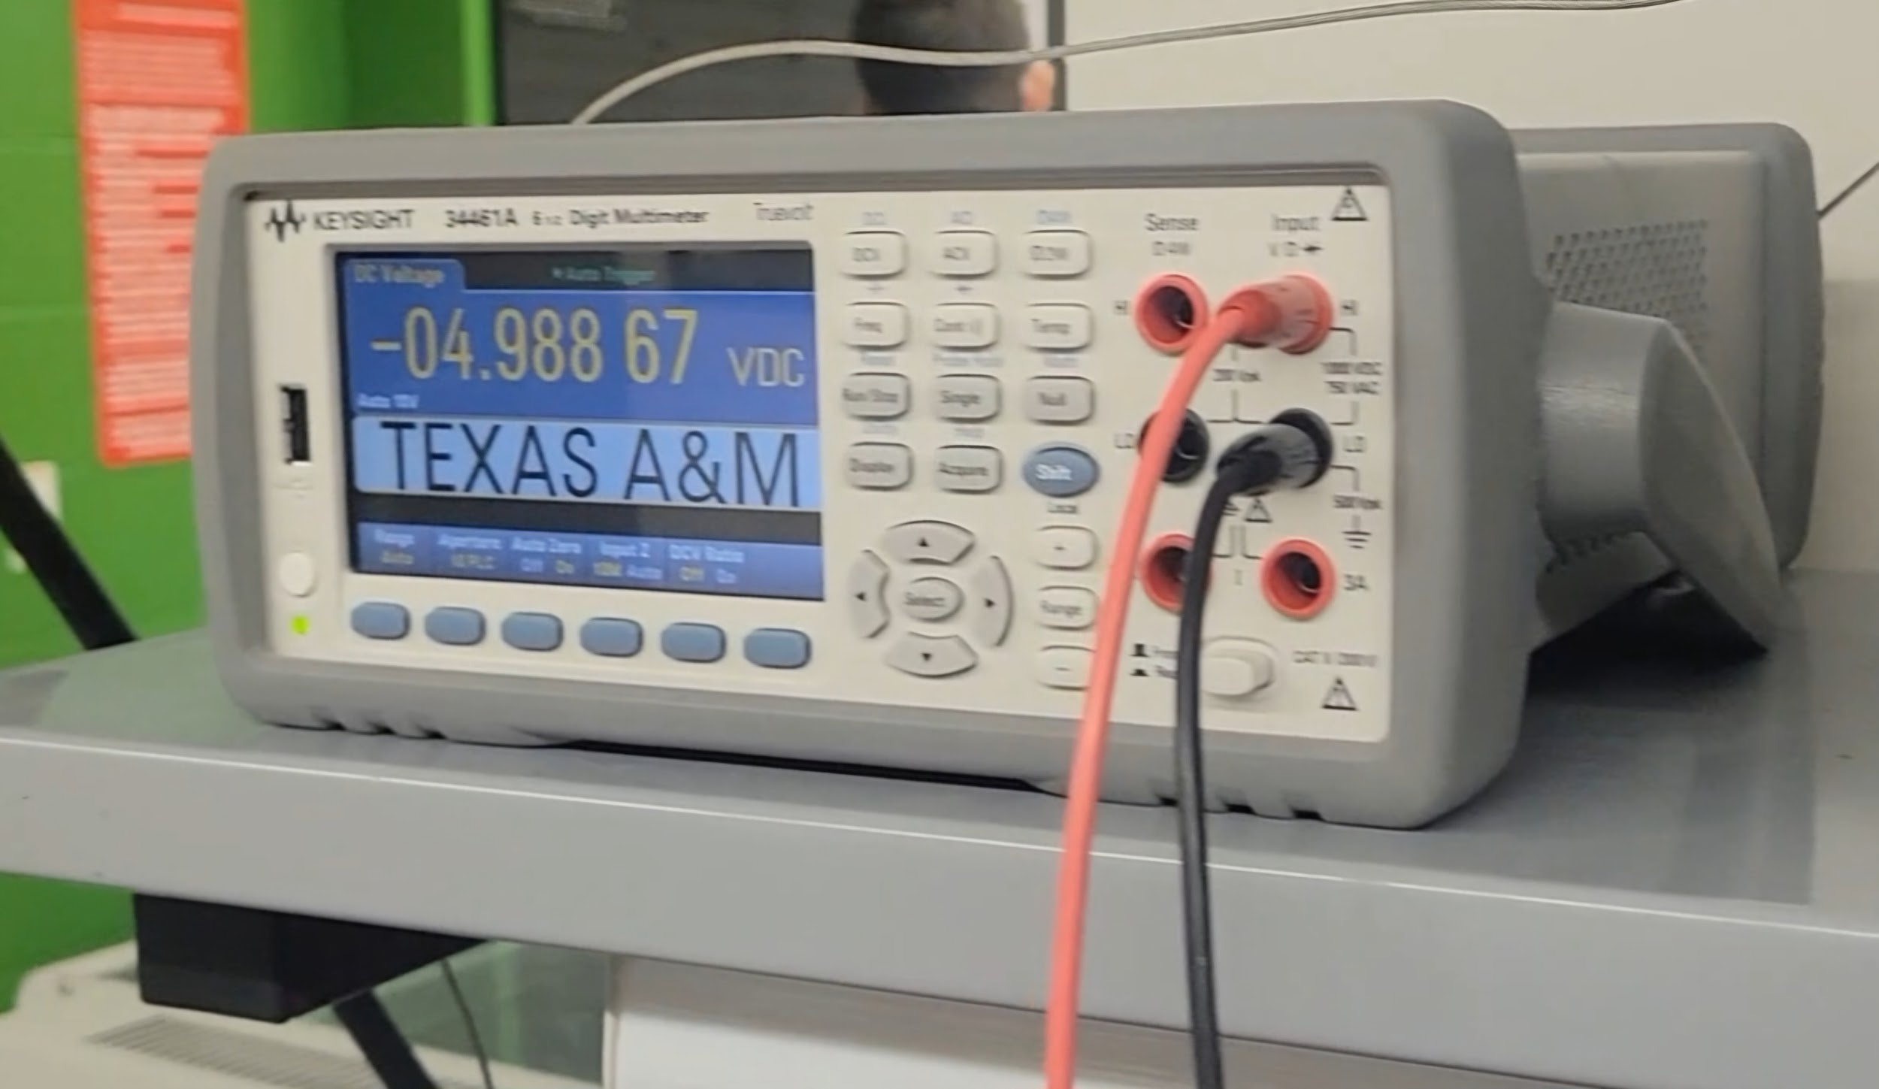
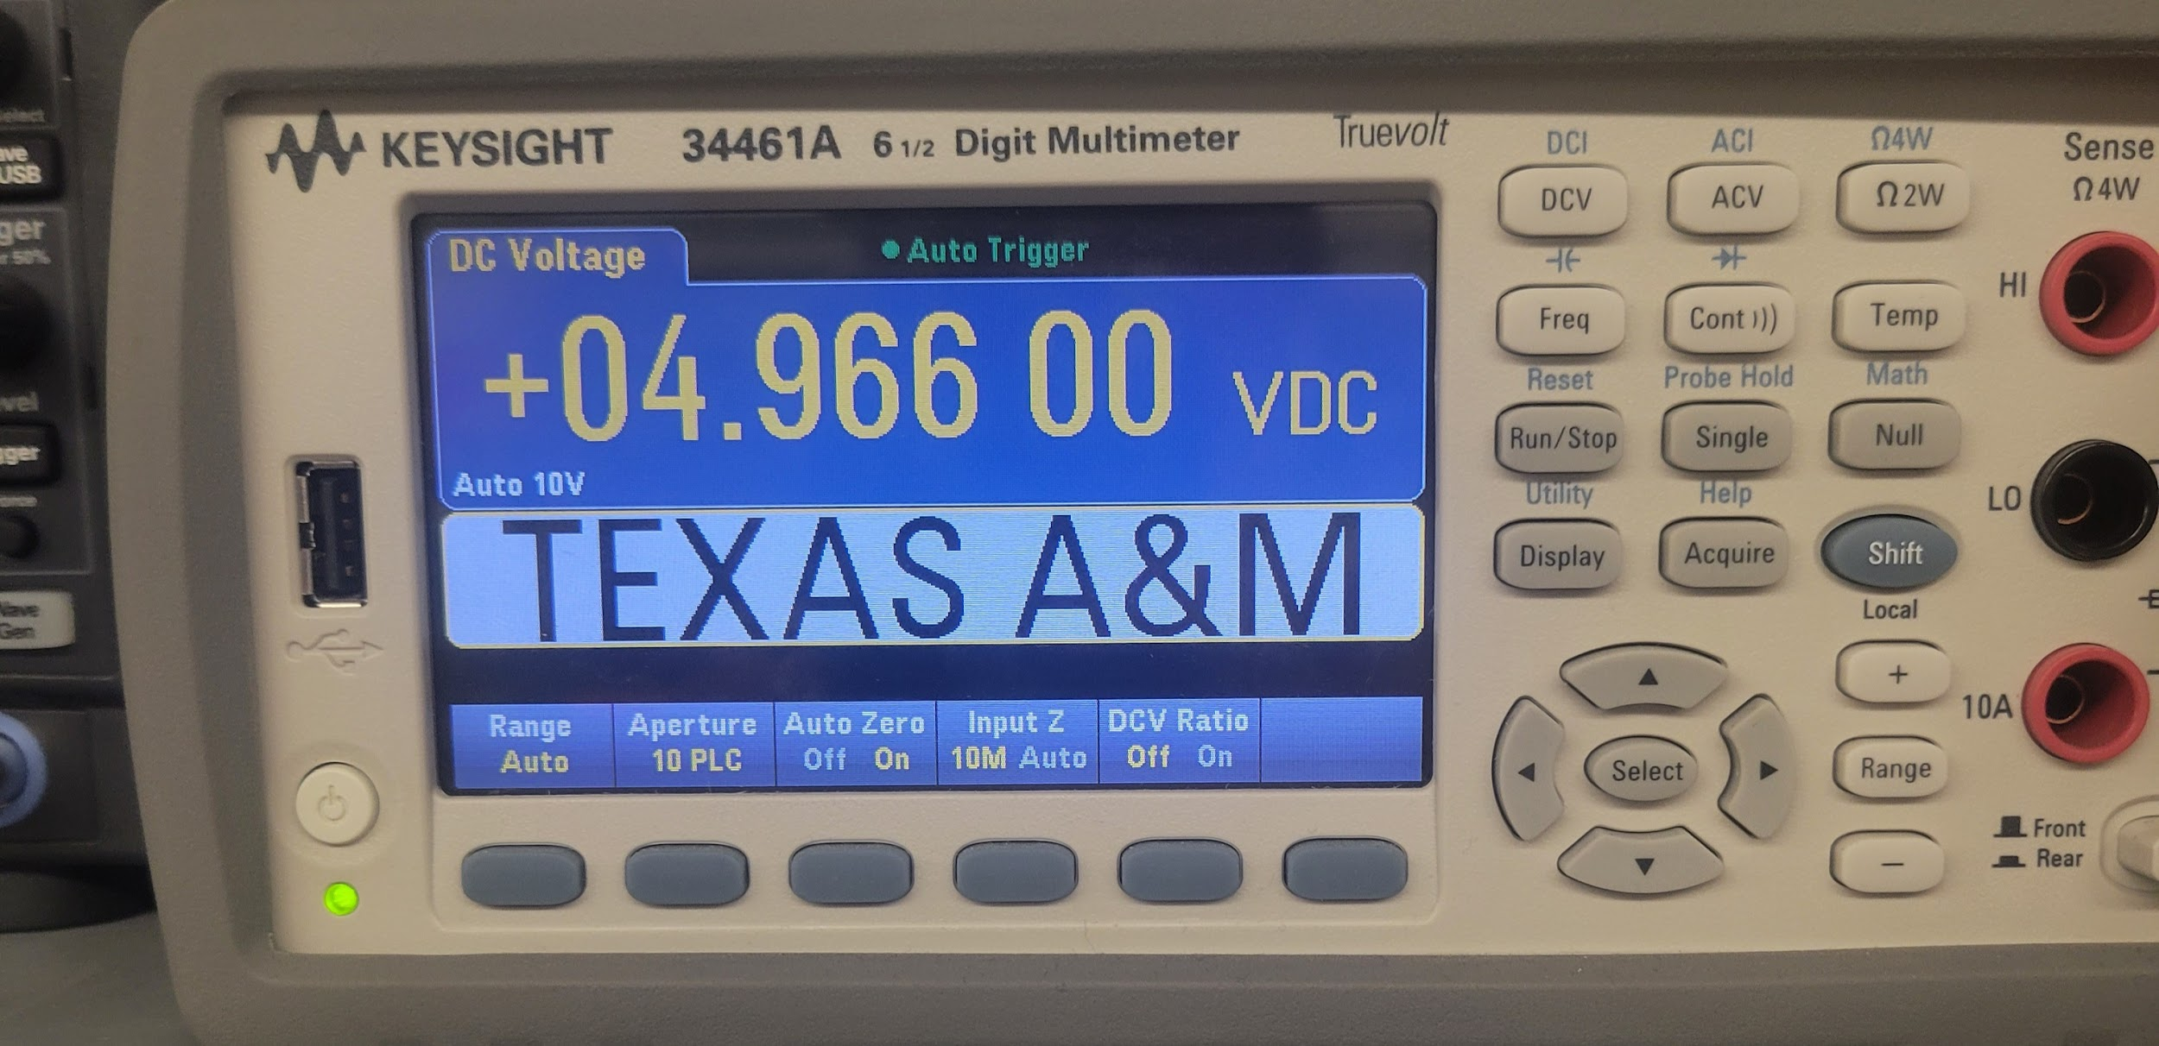
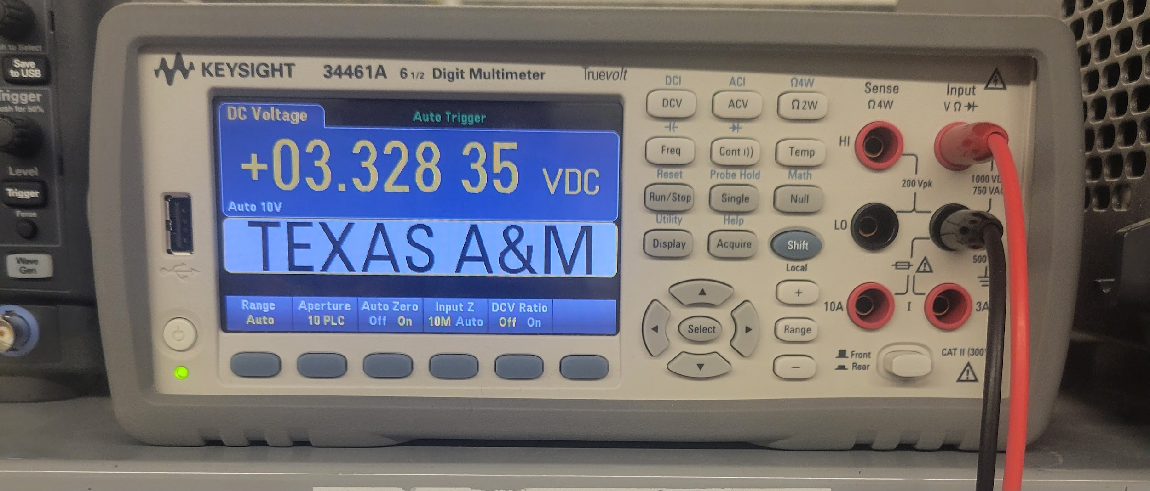
This should all be test results! – show things working, functional test results, error checking, etc
Show test results for integrated systems

Slide 18
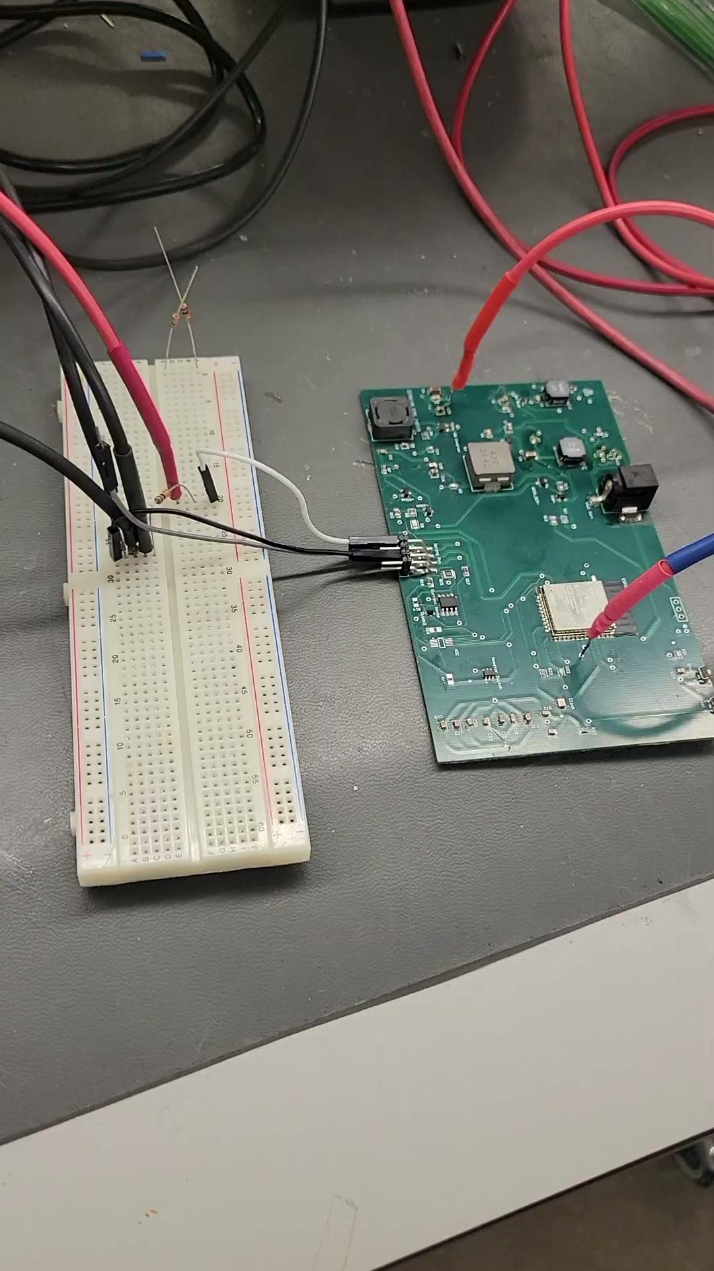

Slide 19
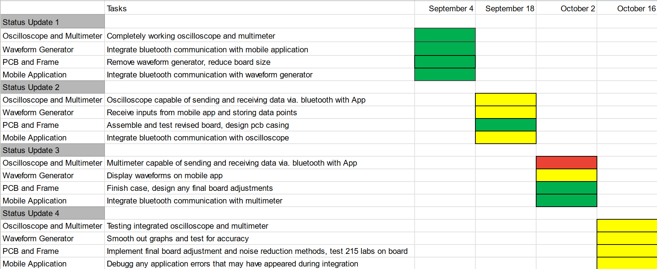
Execution Plan
Notes:
Michelle

Slide 20
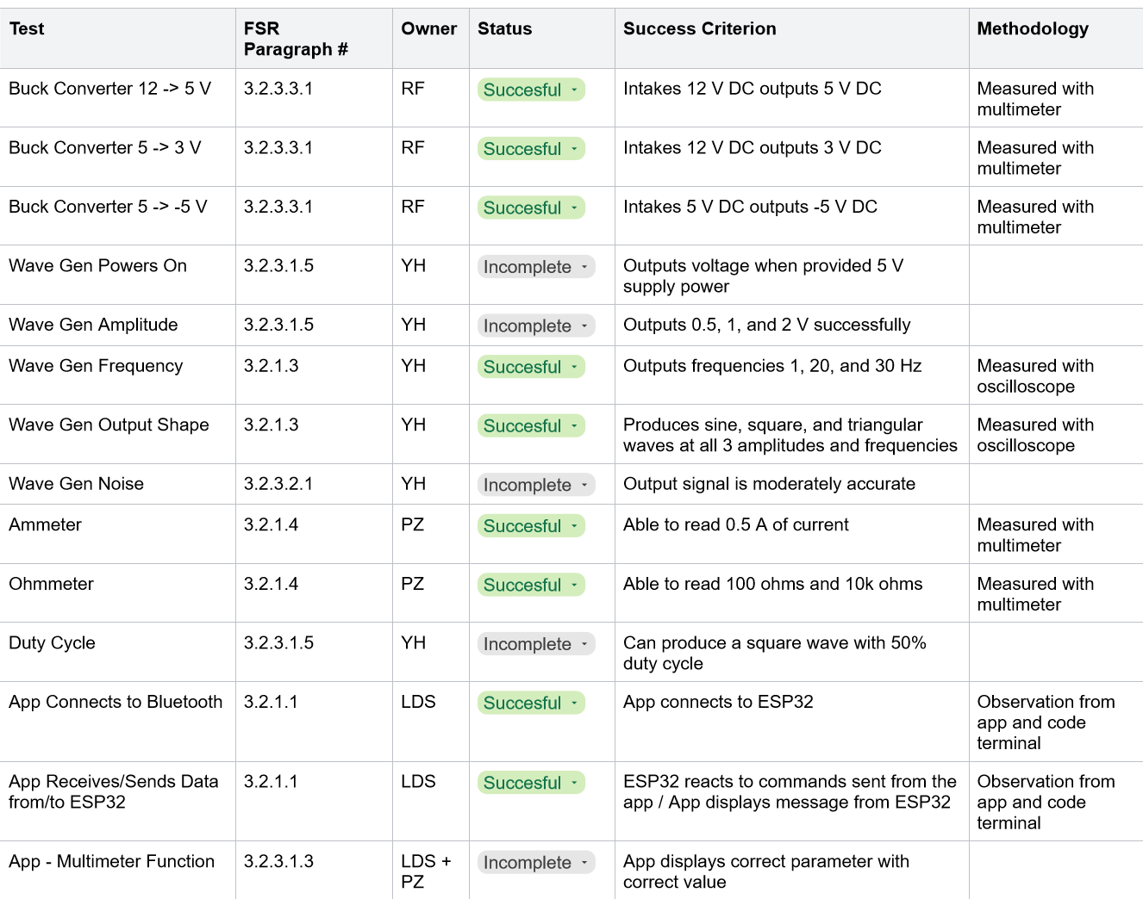
SYSTEM Validation Plan
Notes:
Michelle

Slide 21
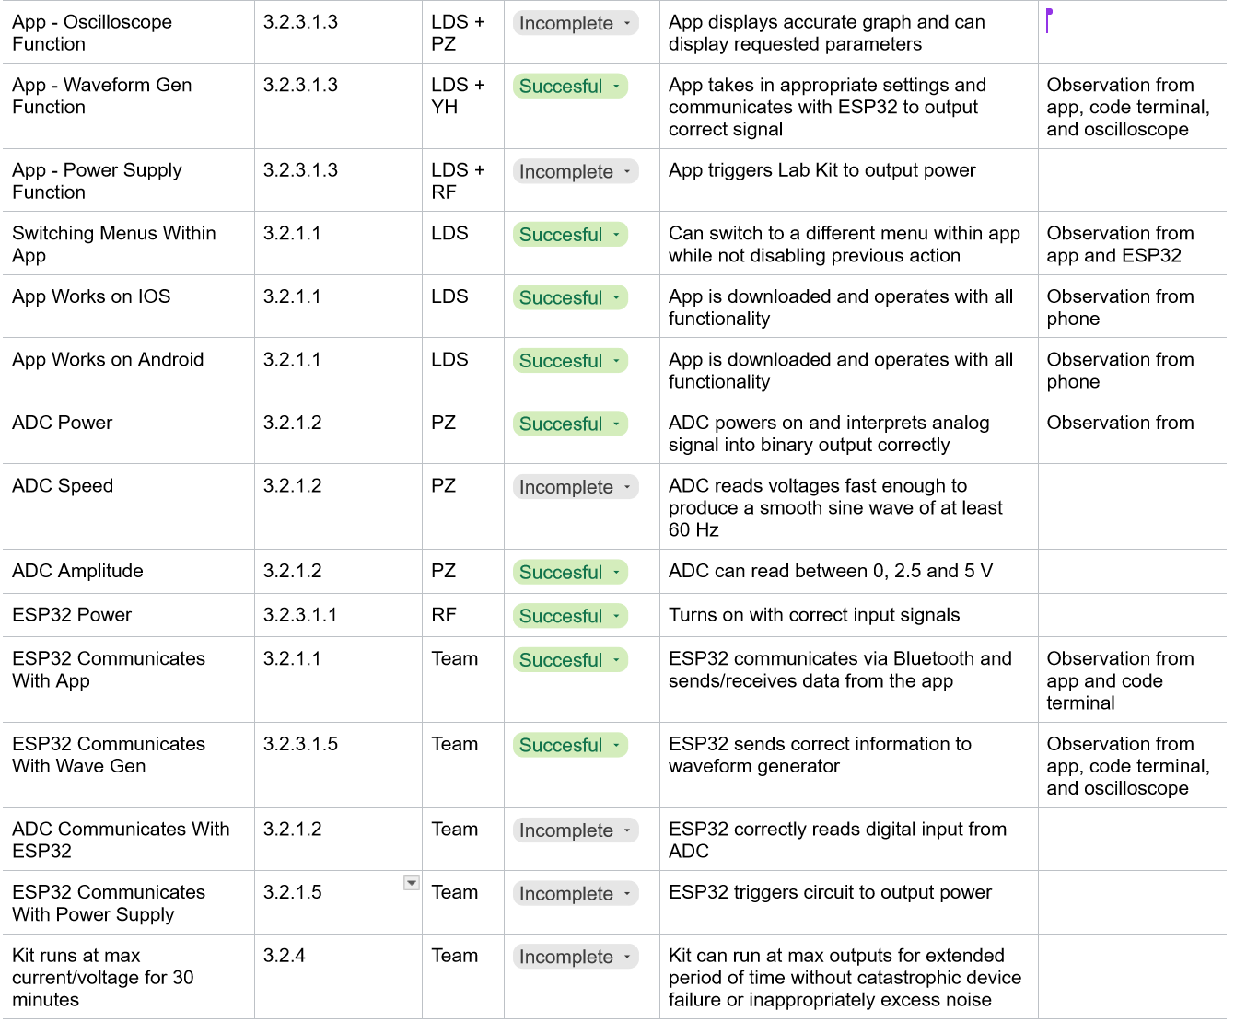
SYSTEM Validation Plan
Notes:
Michelle

Slide 22
Thank you

